Slide 1
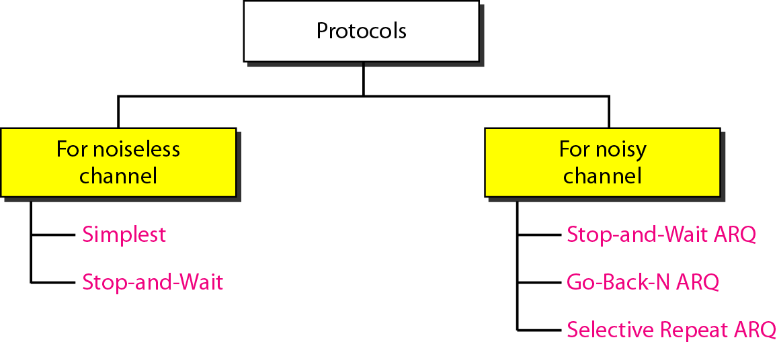
Figure 11.5 Taxonomy of protocols discussed in this chapter

Slide 2

Chapter 11
Data Link Control
Copyright © The McGraw-Hill Companies, Inc. Permission required for reproduction or display.

Slide 3
11-1 FRAMING
The data link layer needs to pack bits into frames, so that each frame is distinguishable from another. Our postal system practices a type of framing. The simple act of inserting a letter into an envelope separates one piece of information from another; the envelope serves as the delimiter.
Topics discussed in this section:
Fixed-Size Framing Variable-Size Framing

Slide 4
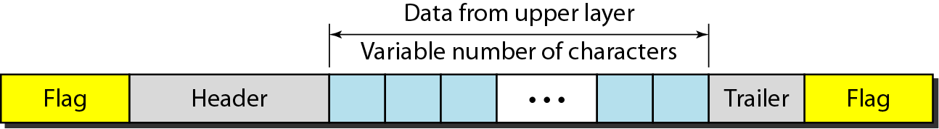
Figure 11.1 A frame in a character-oriented protocol

Slide 5
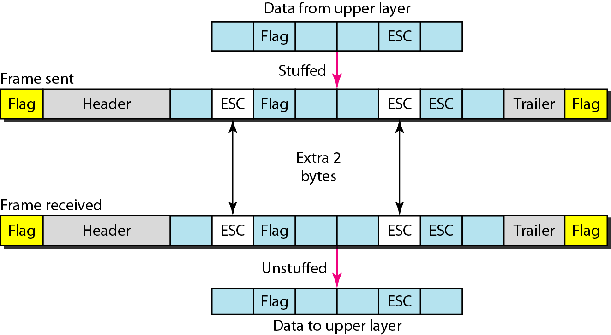
Figure 11.2 Byte stuffing and unstuffing

Slide 6

Note
Byte stuffing is the process of adding 1 extra byte whenever there is a flag or escape character in the text.

Slide 7
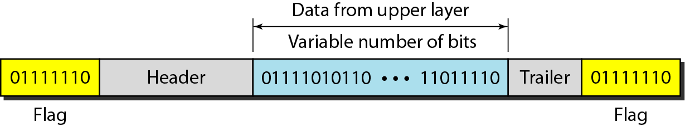
Figure 11.3 A frame in a bit-oriented protocol

Slide 8
Note
Bit stuffing is the process of adding one extra 0 whenever five consecutive 1s follow a 0 in the data, so that the receiver does not mistake
the pattern 0111110 for a flag.

Slide 9
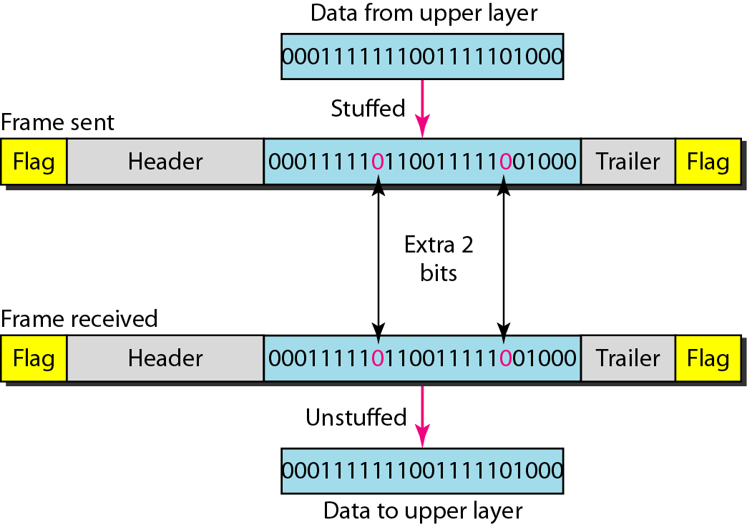
Figure 11.4 Bit stuffing and unstuffing

Slide 10
11-2 FLOW AND ERROR CONTROL
The most important responsibilities of the data link layer are flow control and error control. Collectively, these functions are known as data link control.
Topics discussed in this section:
Flow Control Error Control

Slide 11
Note
Flow control refers to a set of procedures used to restrict the amount of data
that the sender can send before
waiting for acknowledgment.

Slide 12
11-3 PROTOCOLS
Now let us see how the data link layer can combine framing, flow control, and error control to achieve the delivery of data from one node to another. The protocols are normally implemented in software by using one of the common programming languages.

Slide 13
Note
Error control in the data link layer is based on automatic repeat request, which is the retransmission of data.

Slide 14
11-4 NOISELESS CHANNELS
Let us first assume we have an ideal channel in which no frames are lost, duplicated, or corrupted. We introduce two protocols for this type of channel.
Topics discussed in this section:
Simplest Protocol Stop-and-Wait Protocol

Slide 15
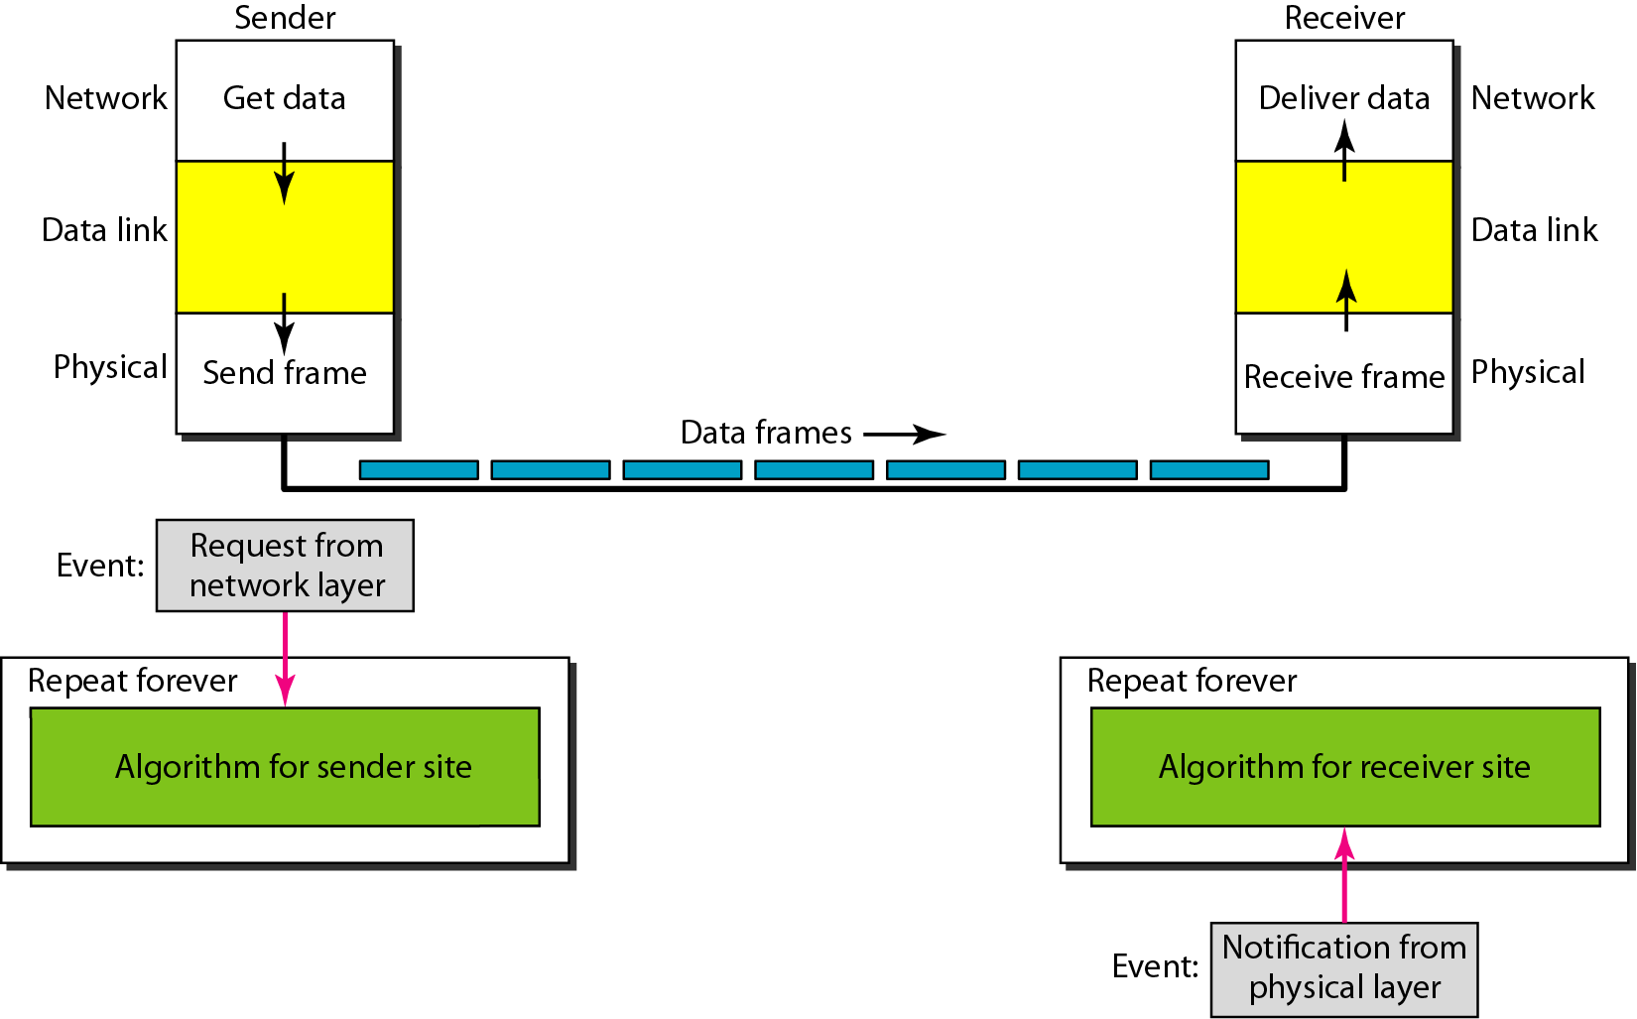
Figure 11.6 The design of the simplest protocol with no flow or error control

Slide 16
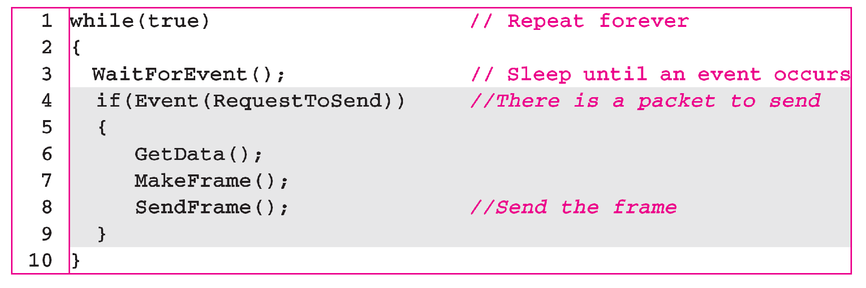
Algorithm 11.1 Sender-site algorithm for the simplest protocol

Slide 17
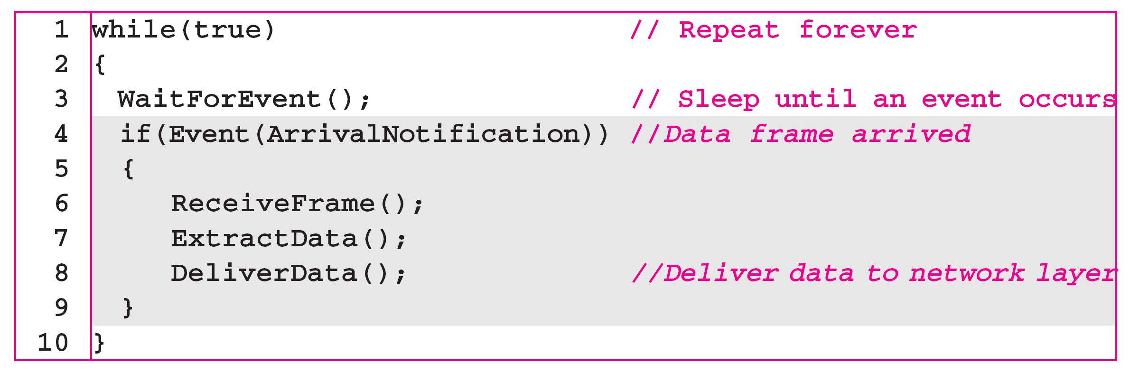
Algorithm 11.2 Receiver-site algorithm for the simplest protocol

Slide 18
Example 11.1
Figure 11.7 shows an example of communication using this protocol. It is very simple. The sender sends a sequence of frames without even thinking about the receiver. To send three frames, three events occur at the sender site and three events at the receiver site. Note that the data frames are shown by tilted boxes; the height of the box defines the transmission time difference between
the first bit and the last bit in the frame.

Slide 19
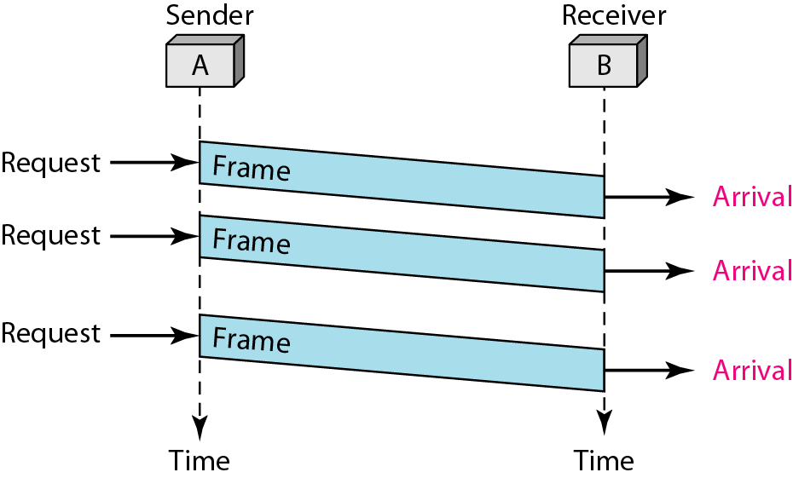
Figure 11.7 Flow diagram for Example 11.1

Slide 20
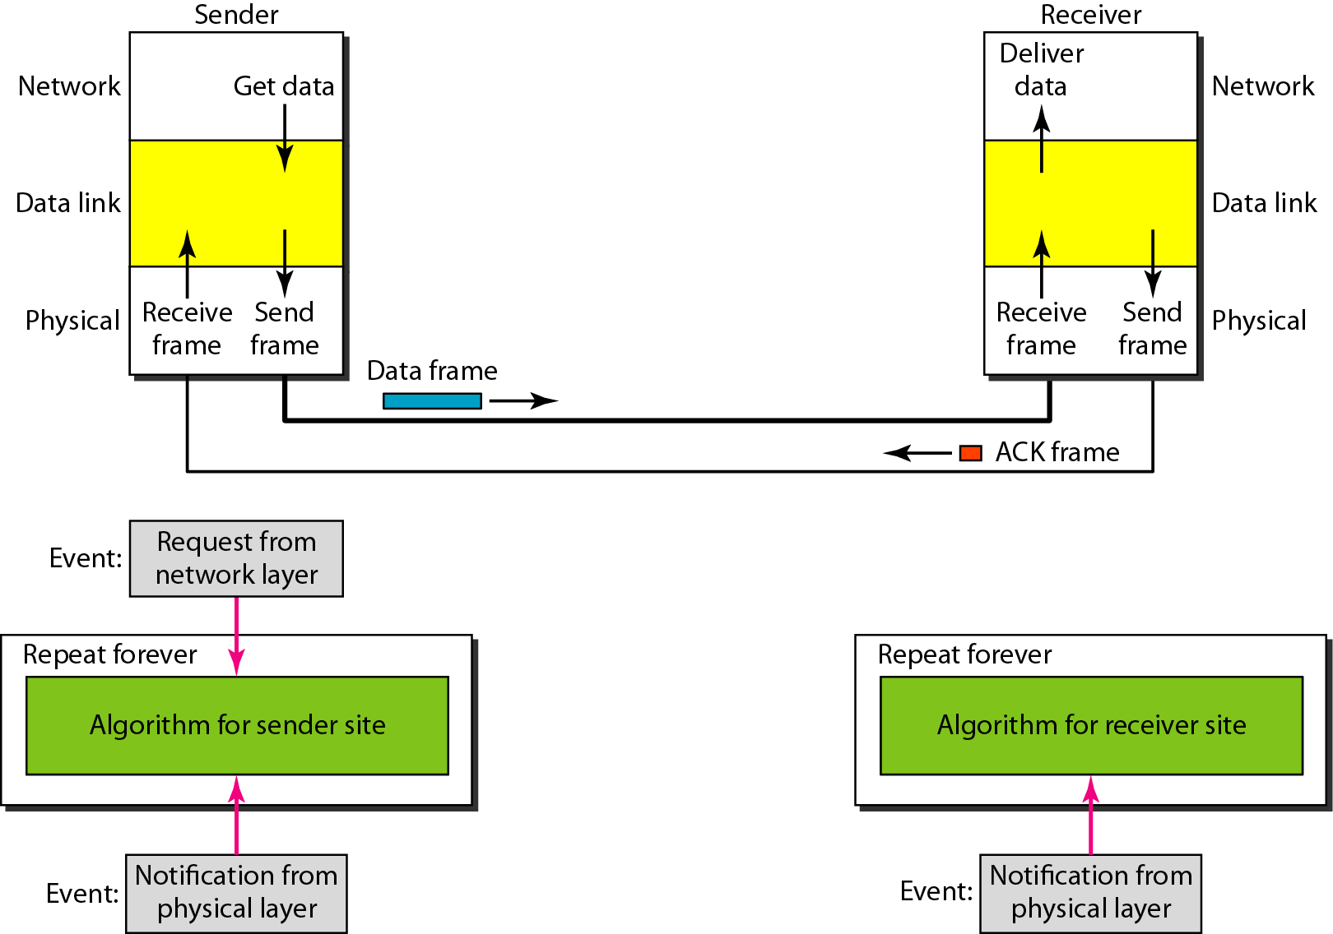
Figure 11.8 Design of Stop-and-Wait Protocol

Slide 21
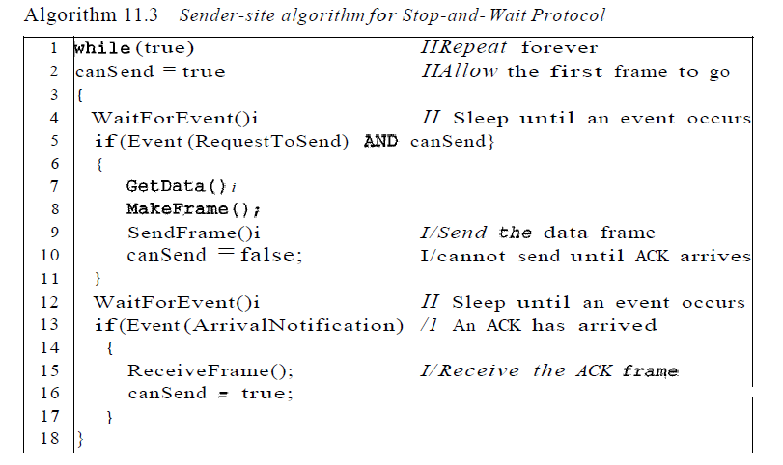
Algorithm 11.3 Sender-site algorithm for Stop-and-Wait Protocol

Slide 22
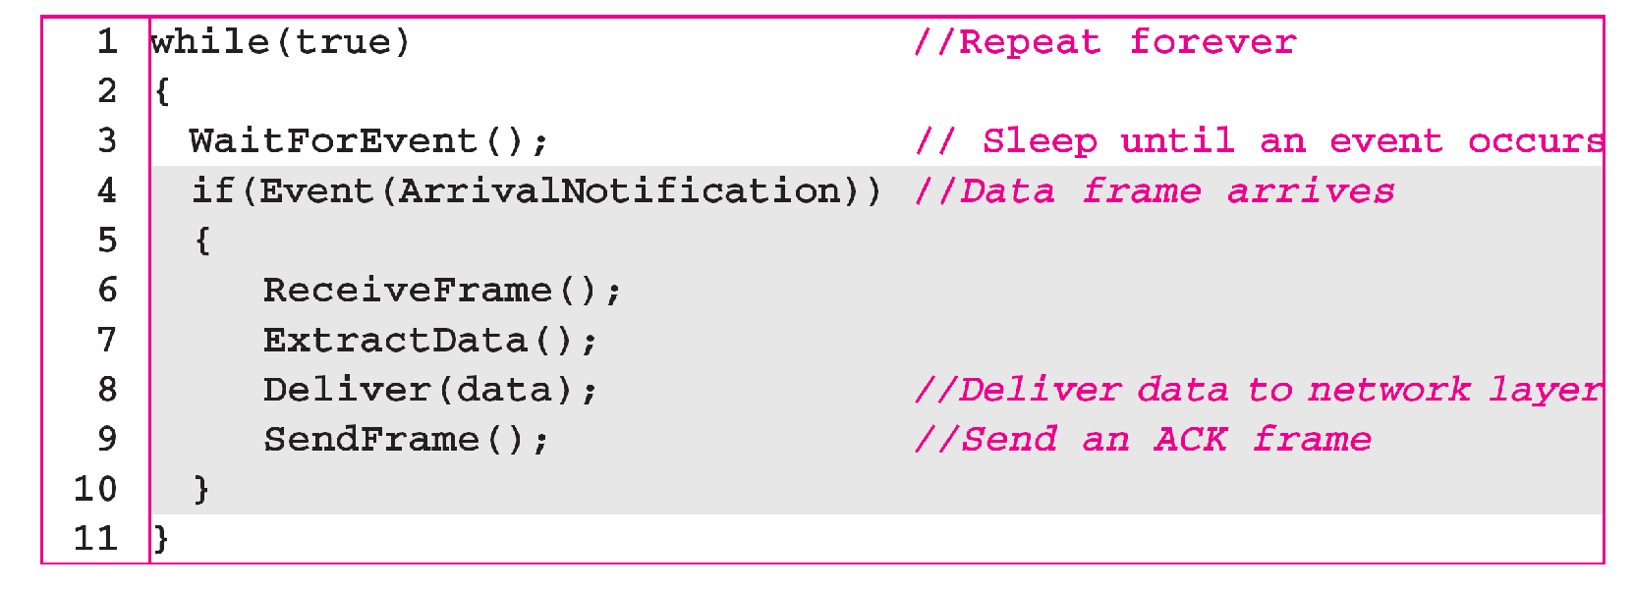
Algorithm 11.4 Receiver-site algorithm for Stop-and-Wait Protocol

Slide 23
Example 11.2
Figure 11.9 shows an example of communication using this protocol. It is still very simple. The sender sends one frame and waits for feedback from the receiver. When the ACK arrives, the sender sends the next frame. Note that sending two frames in the protocol involves the sender in four events and the receiver in two events.

Slide 24
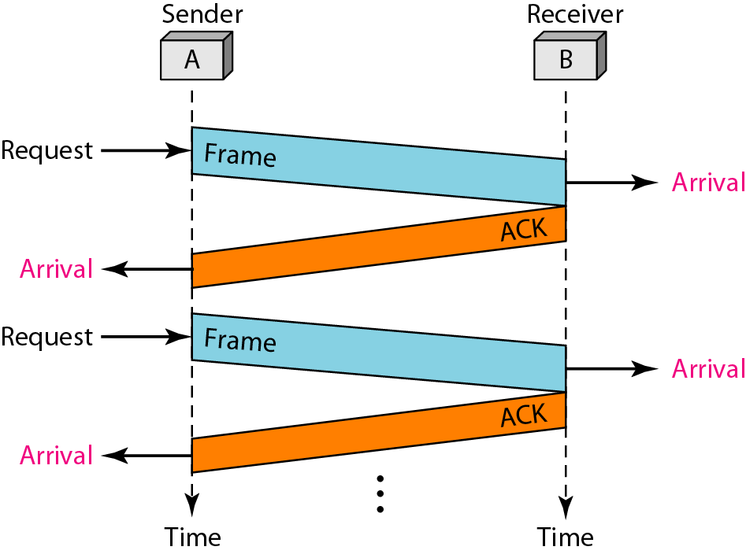
Figure 11.9 Flow diagram for Example 11.2

Slide 25
11-5 NOISY CHANNELS
Although the Stop-and-Wait Protocol gives us an idea of how to add flow control to its predecessor, noiseless channels are nonexistent. We discuss three protocols in this section that use error control.
Topics discussed in this section:
Stop-and-Wait Automatic Repeat Request Go-Back-N Automatic Repeat Request Selective Repeat Automatic Repeat Request

Slide 26
Note
Error correction in Stop-and-Wait ARQ is done by keeping a copy of the sent frame and retransmitting of the frame when the timer expires.

Slide 27
Note
In Stop-and-Wait ARQ, we use sequence numbers to number the frames.
The sequence numbers are based on modulo-2 arithmetic.

Slide 28
Note
In Stop-and-Wait ARQ, the acknowledgment number always announces in modulo-2 arithmetic the sequence number of the next frame expected.

Slide 29
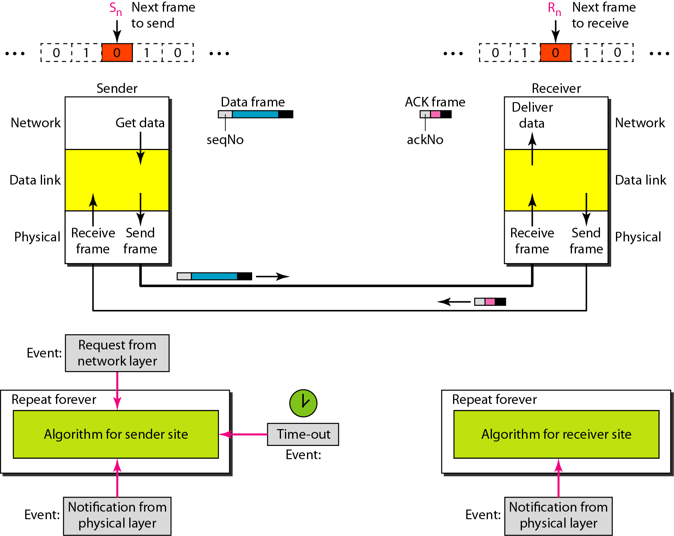
Figure 11.10 Design of the Stop-and-Wait ARQ Protocol

Slide 30
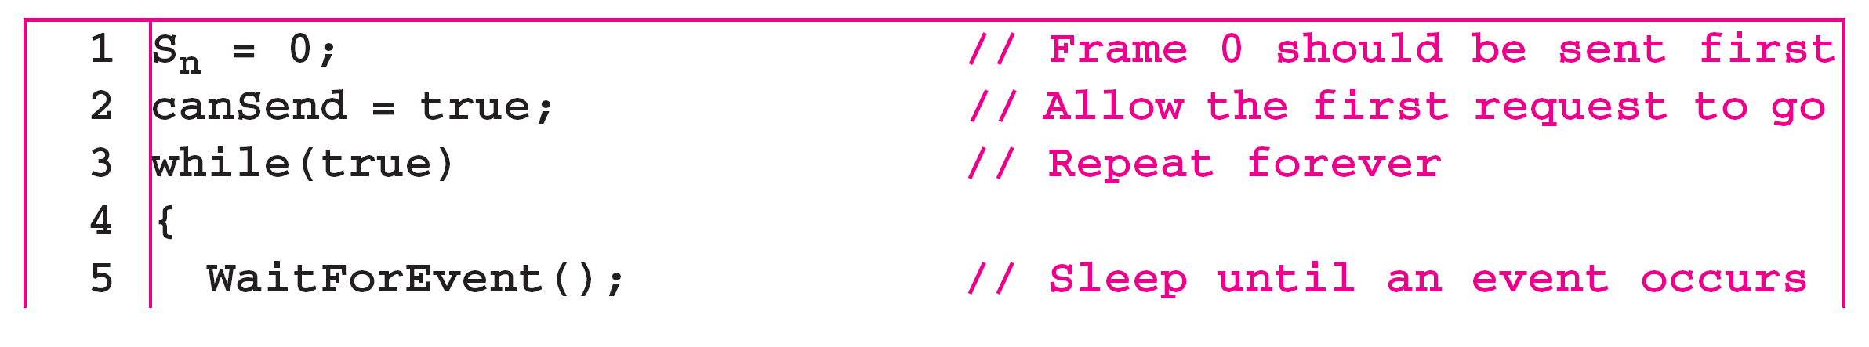
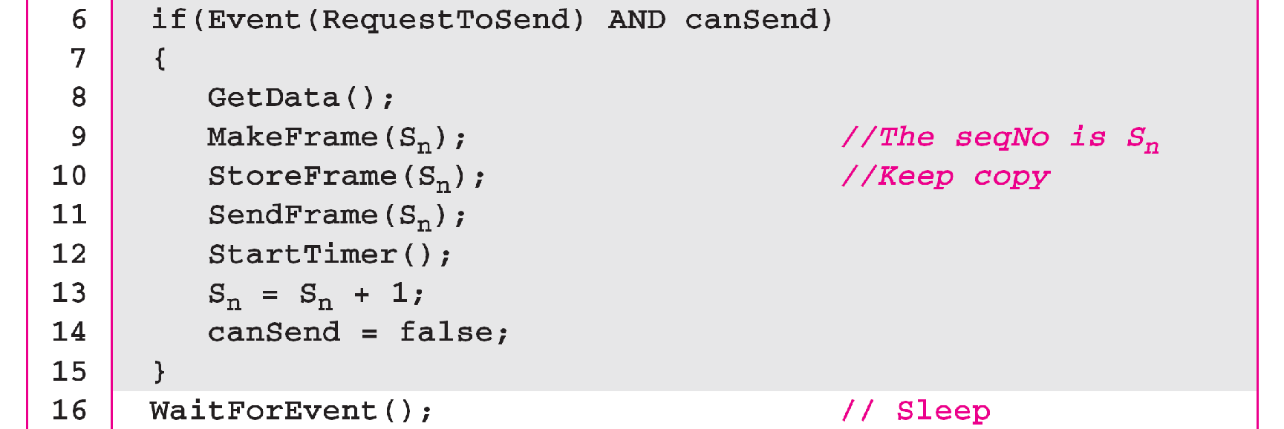
Algorithm 11.5 Sender-site algorithm for Stop-and-Wait ARQ
_{(continued)}

Slide 31
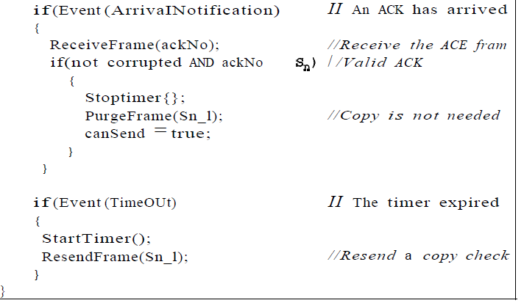
Algorithm 11.5 Sender-site algorithm for Stop-and-Wait ARQ
_{(continued)}

Slide 32
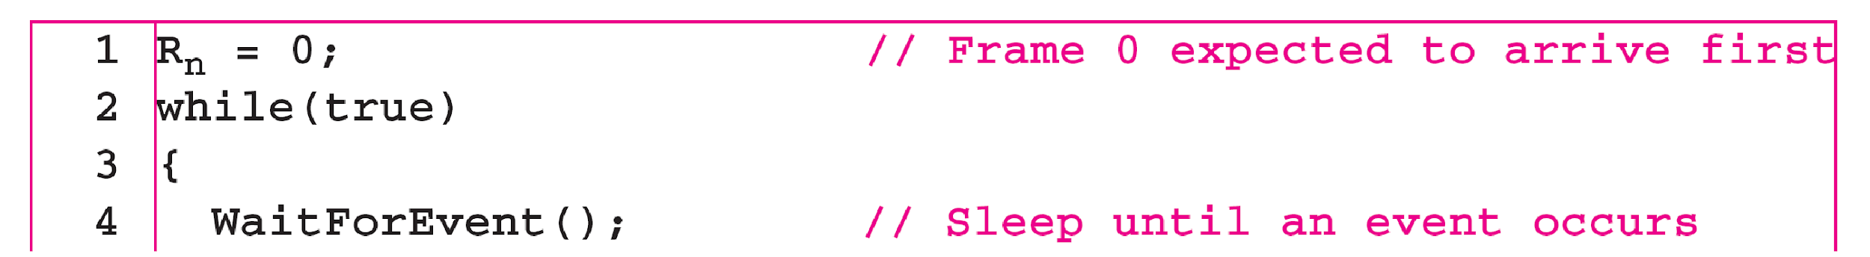
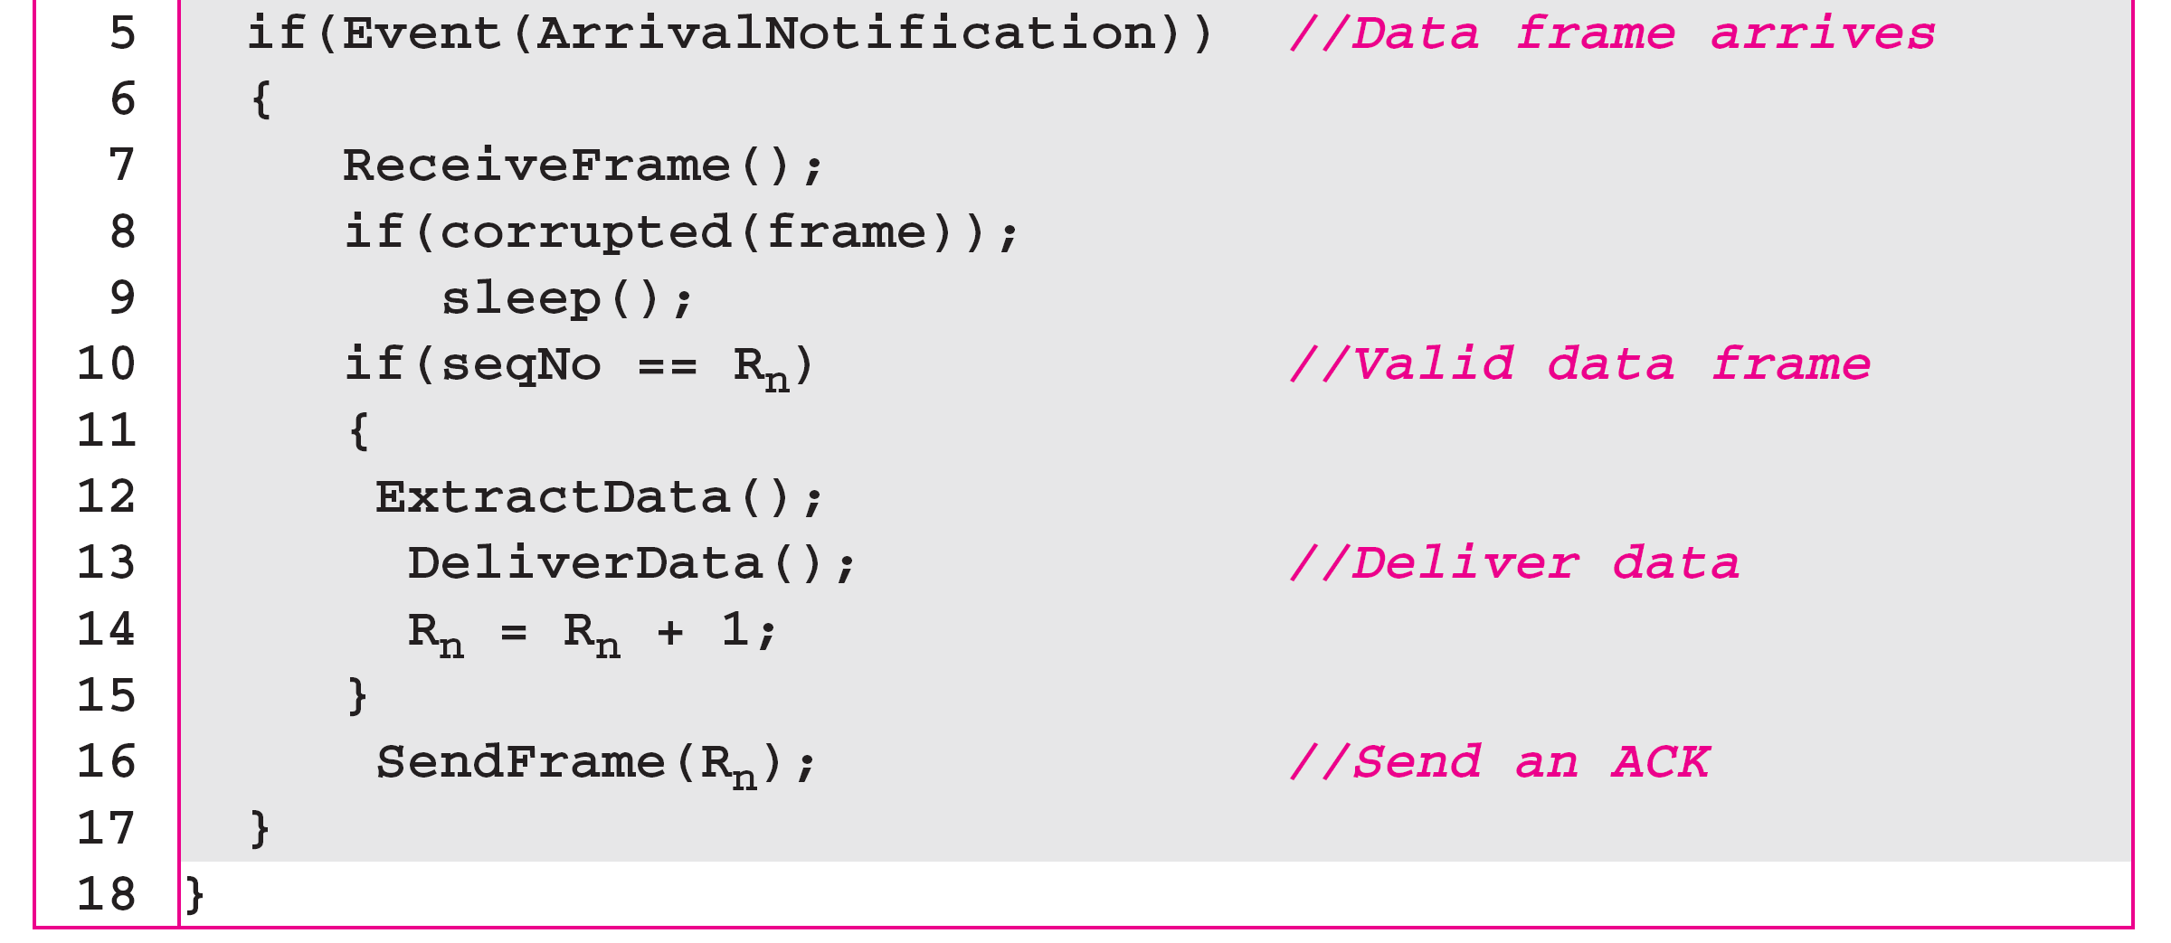
Algorithm 11.6 Receiver-site algorithm for Stop-and-Wait ARQ Protocol

Slide 33
Example 11.3
Figure 11.11 shows an example of Stop-and-Wait ARQ. Frame 0 is sent and acknowledged. Frame 1 is lost and resent after the time-out. The resent frame 1 is acknowledged and the timer stops. Frame 0 is sent and acknowledged, but the acknowledgment is lost. The sender has no idea if the frame or the acknowledgment is lost, so after the time-out, it resends frame 0, which is acknowledged.

Slide 34
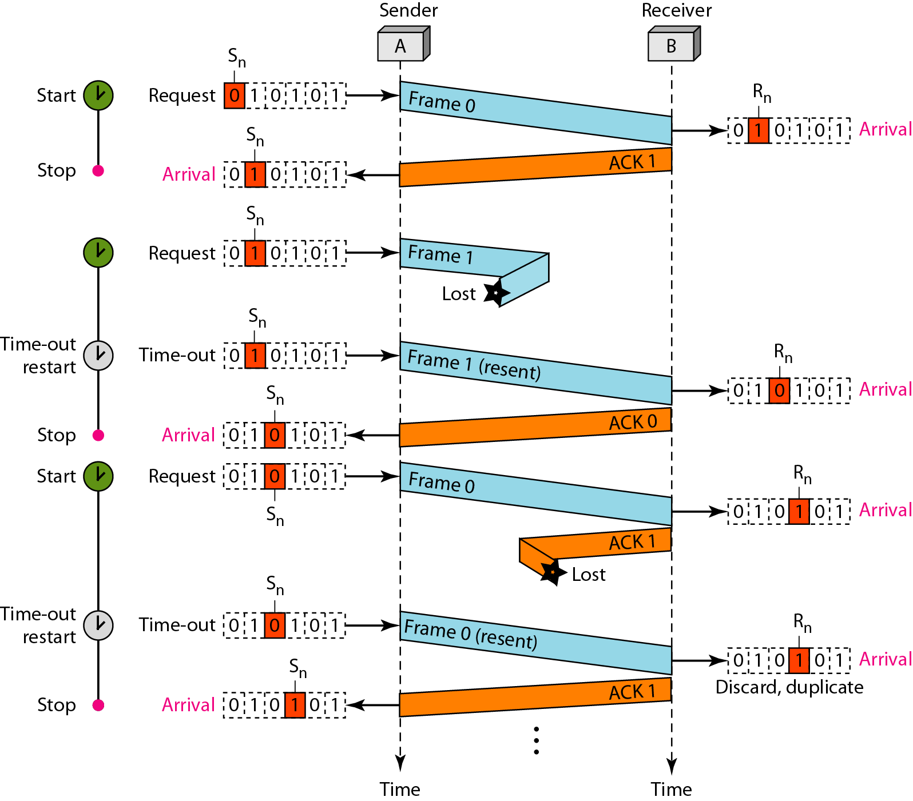
Figure 11.11 Flow diagram for Example 11.3

